Slide 1

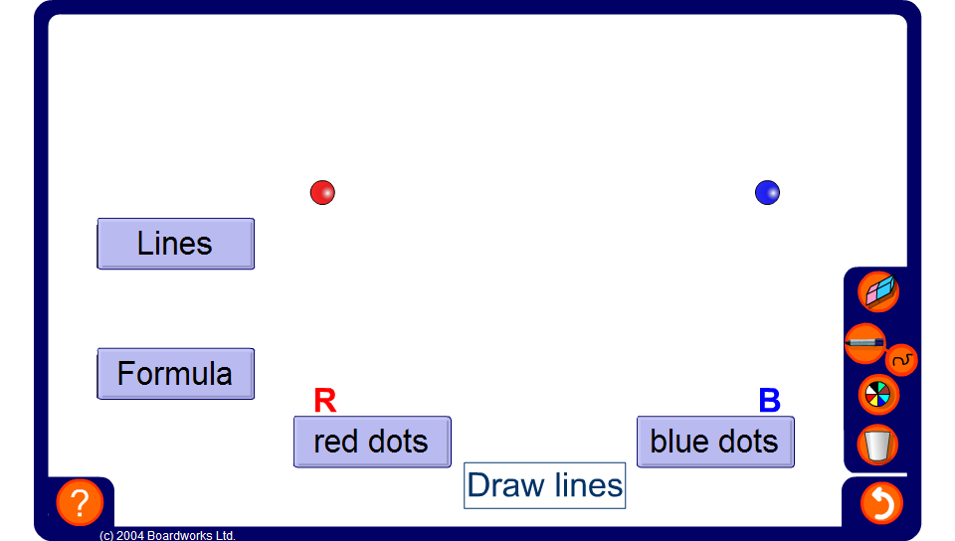


Connecting Dots
Notes:
Red dots can be connected to blue dots using straight lines.
For example, if I have two red dots (show two red dots on the board) and three blue dots (show three blue dots on the board). How many lines can I draw to connect each red dot to reach blue dot?
Answer: Six lines. Three lines connecting the first red dot to each of the three blue dots and three lines connecting the second red dot to each of the three blue dots.
Press the “Draw lines” button. L, the number of lines = 6.
Demonstrate a few more examples.
Ask pupils for a formula to find, L, the number of lines, given R, the number of red dots and B, the number of blue dots.
Take some suggestions, asking pupils to justify their formulae in the context of the problem, before pressing the show formula button.
L = RB (Remember that we don’t need to write the multiplication sign in algebra).
Ask pupils for a justification of this formula.
Link:
A4 Sequences – sequences from practical contexts.

